Slide 1

Practice of Deep Learning Day 1, Part 2/4
Matthieu De Mari

Slide 2
About this lecture
What is polynomial regression and how to implement it?
What is regularization and how to implement it in Ridge regression?
What is overfitting and why is it bad?
What is underfitting and why is it bad?
What is generalization and how to evaluate it?

Slide 3
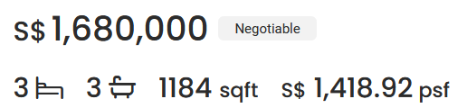
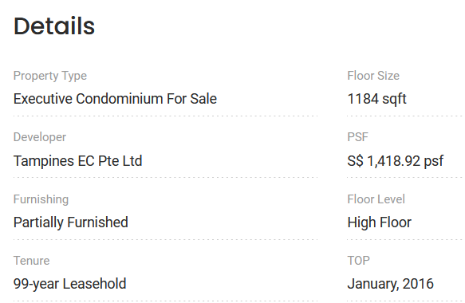

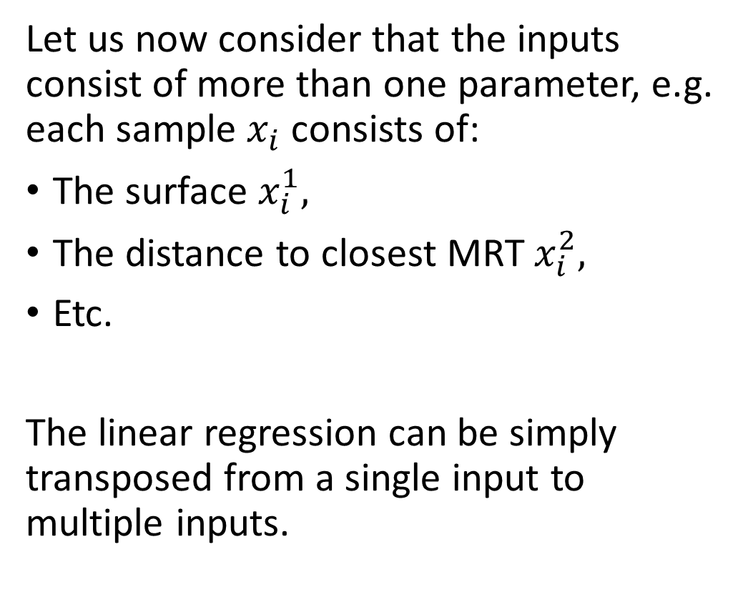
Same problem, v2.0
Let us now consider that the inputs consist of more than one parameter, e.g. each sample $x_{i}$ consists of:
The surface $x_{i}^{1},$
The distance to closest MRT $x_{i}^{2},$
Etc.
The linear regression can be simply transposed from a single input to multiple inputs.

Slide 4
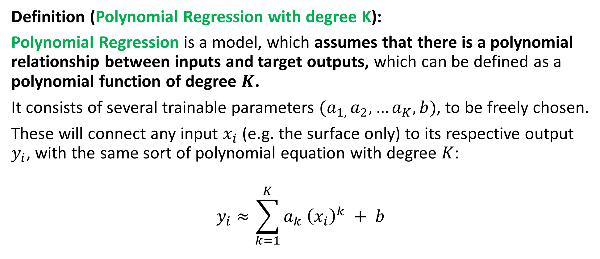
From Linear to Polynomial Regression
Definition (Polynomial Regression with degree K):
Polynomial Regression is a model, which assumes that there is a polynomial relationship between inputs and target outputs, which can be defined as a polynomial function of degree $K$.
It consists of several trainable parameters $(a_{1, }a_{2},…a_{K},b)$, to be freely chosen.
These will connect any input $x_{i}$ (e.g. the surface only) to its respective output $y_{i}$, with the same sort of polynomial equation with degree $K$:
$$y_{i}≈\sum_{k=1}^{K}{a_{k} {\left(x_{i}\right)}^{k}} + b$$

Slide 5
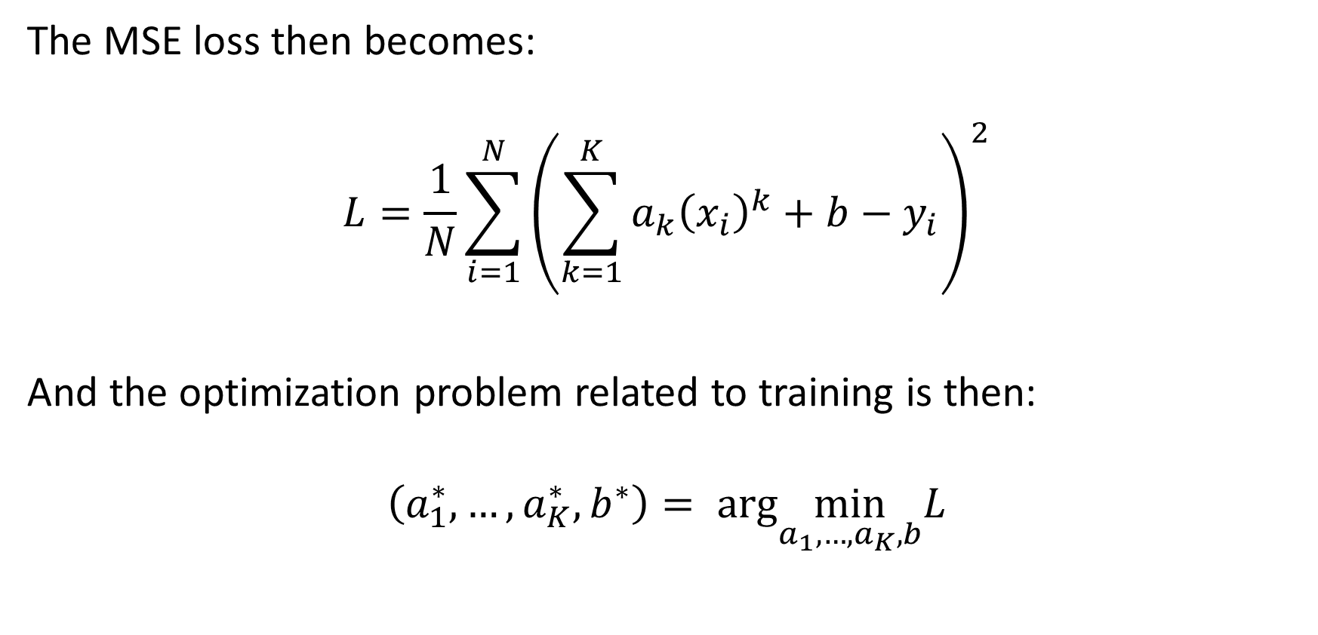
Extension to Polynomial Regression
The MSE loss then becomes:
$$L=\frac{1}{N}\sum_{i=1}^{N}{{\left(\sum_{k=1}^{K}{a_{k}{\left(x_{i}\right)}^{k}}+b−y_{i}\right)}^{2}}$$
And the optimization problem related to training is then:
$$\left(a_{1}^{∗}, …,a_{K}^{∗}, b^{∗}\right)= arg\min_{a_{1},…,a_{K},b}L$$

Slide 6
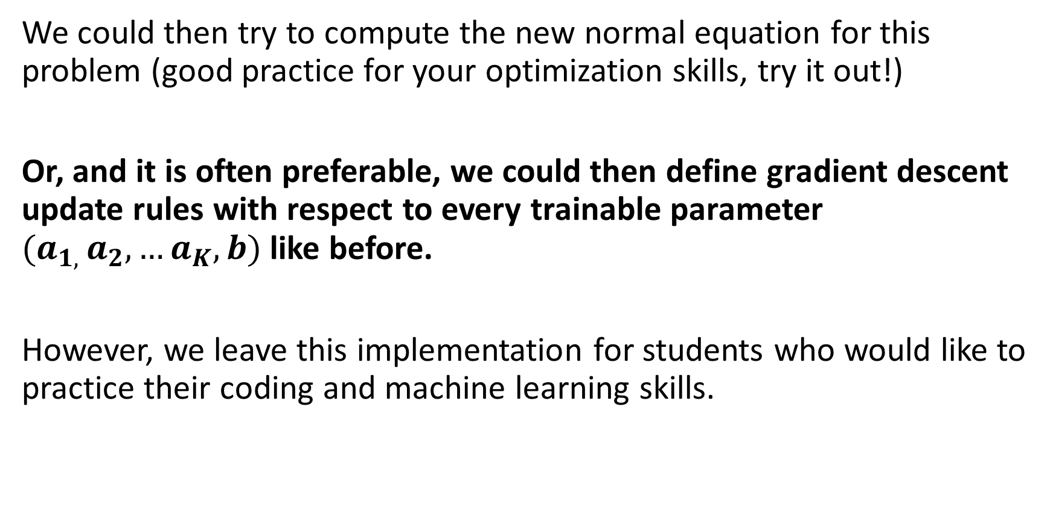
Extension to Polynomial Regression
We could then try to compute the new normal equation for this problem (good practice for your optimization skills, try it out!)
Or, and it is often preferable, we could then define gradient descent update rules with respect to every trainable parameter $(a_{1, }a_{2},…a_{K},b)$ like before.
However, we leave this implementation for students who would like to practice their coding and machine learning skills.

Slide 7
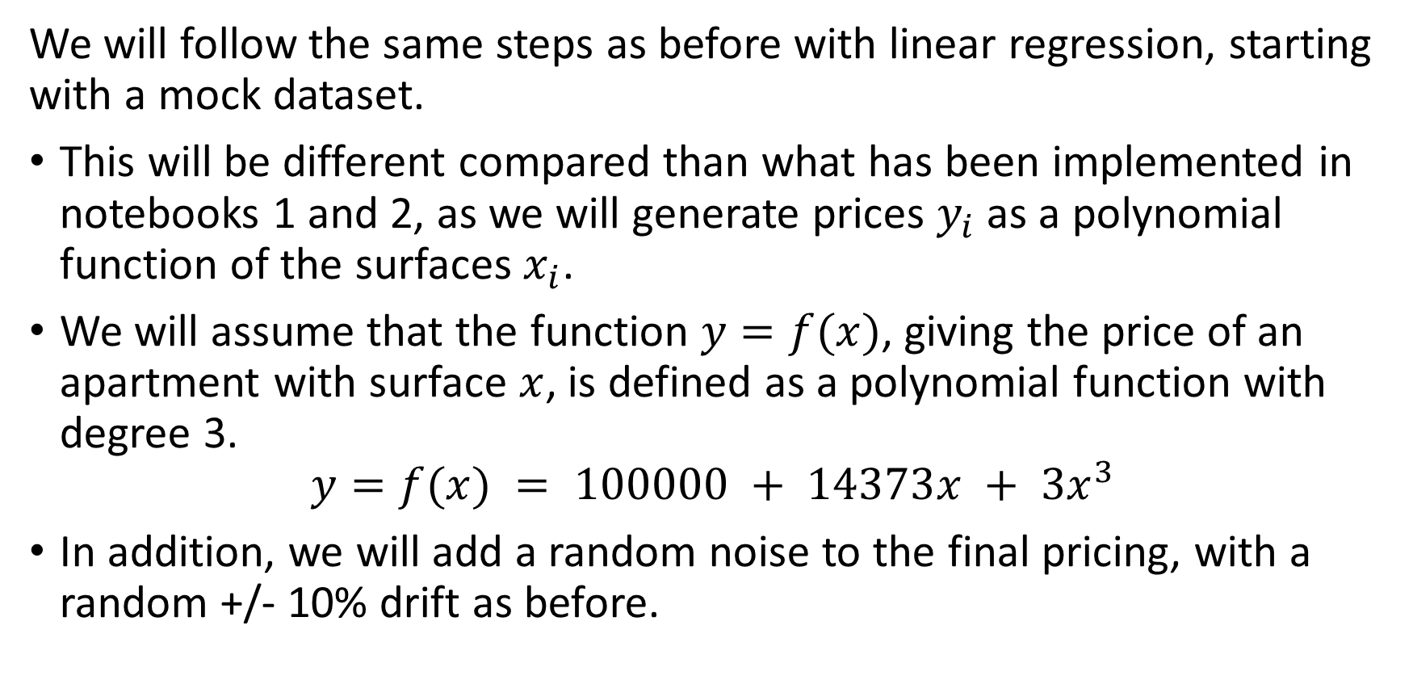
From Linear to Polynomial Regression
We will follow the same steps as before with linear regression, starting with a mock dataset.
This will be different compared than what has been implemented in notebooks 1 and 2, as we will generate prices $y_{i}$ as a polynomial function of the surfaces $x_{i}$.
We will assume that the function $y=f(x)$, giving the price of an apartment with surface $x$, is defined as a polynomial function with degree 3.
$$y=f(x) = 100000 + 14373x + 3x^{3}$$
In addition, we will add a random noise to the final pricing, with a random +/- 10% drift as before.

Slide 8
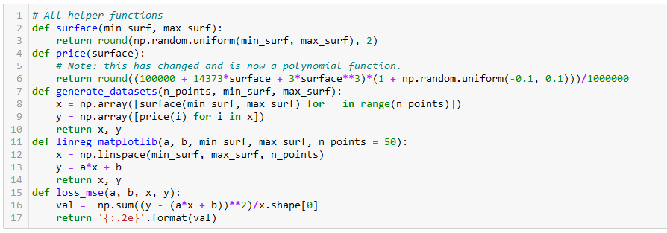
From Linear to Polynomial Regression

Slide 9
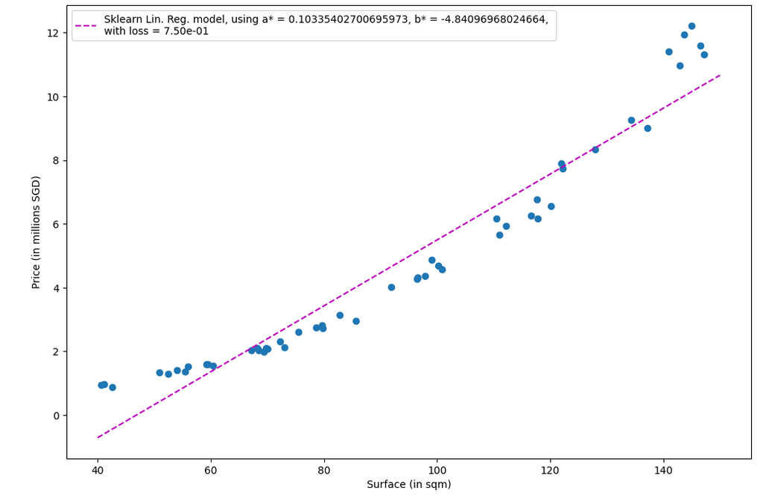
Data no longer shows linearity, which is expected.
Using a Linear Regressor would be a mistake here, as it would not properly fit the data.

Slide 10
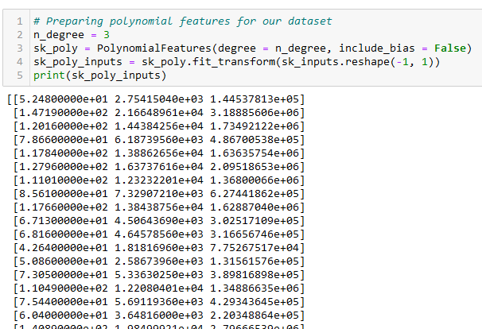
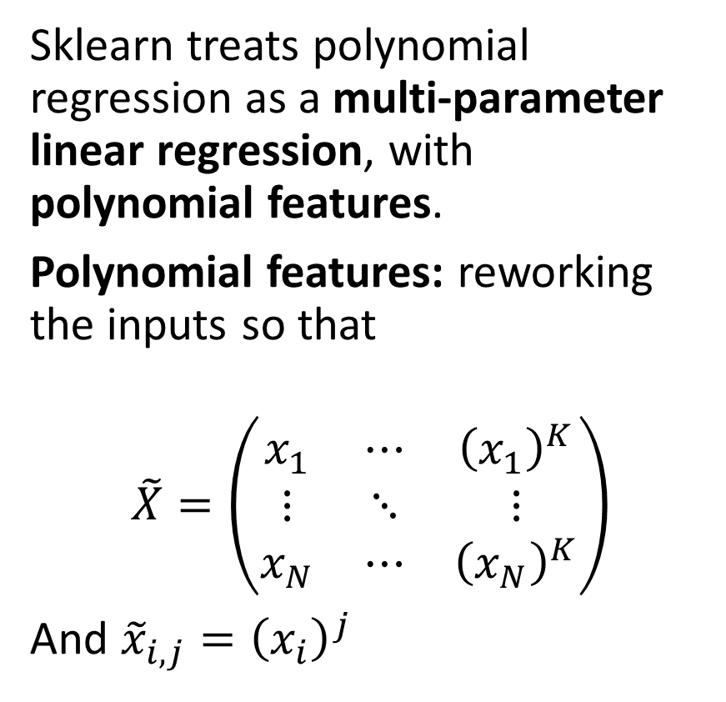
Polynomial Regression with sklearn
Sklearn treats polynomial regression as a multi-parameter linear regression, with polynomial features.
Polynomial features: reworking the inputs so that
$$\tilde{X}=\left(\begin{matrix}x_{1} & ⋯ & {\left(x_{1}\right)}^{K} \\ ⋮ & ⋱ & ⋮ \\ x_{N} & ⋯ & {\left(x_{N}\right)}^{K}\end{matrix}\right)$$
And ${\tilde{x}}_{i,j}={\left(x_{i}\right)}^{j}$

Slide 11
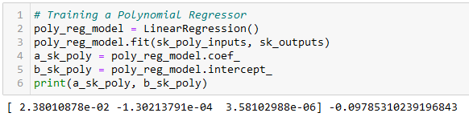
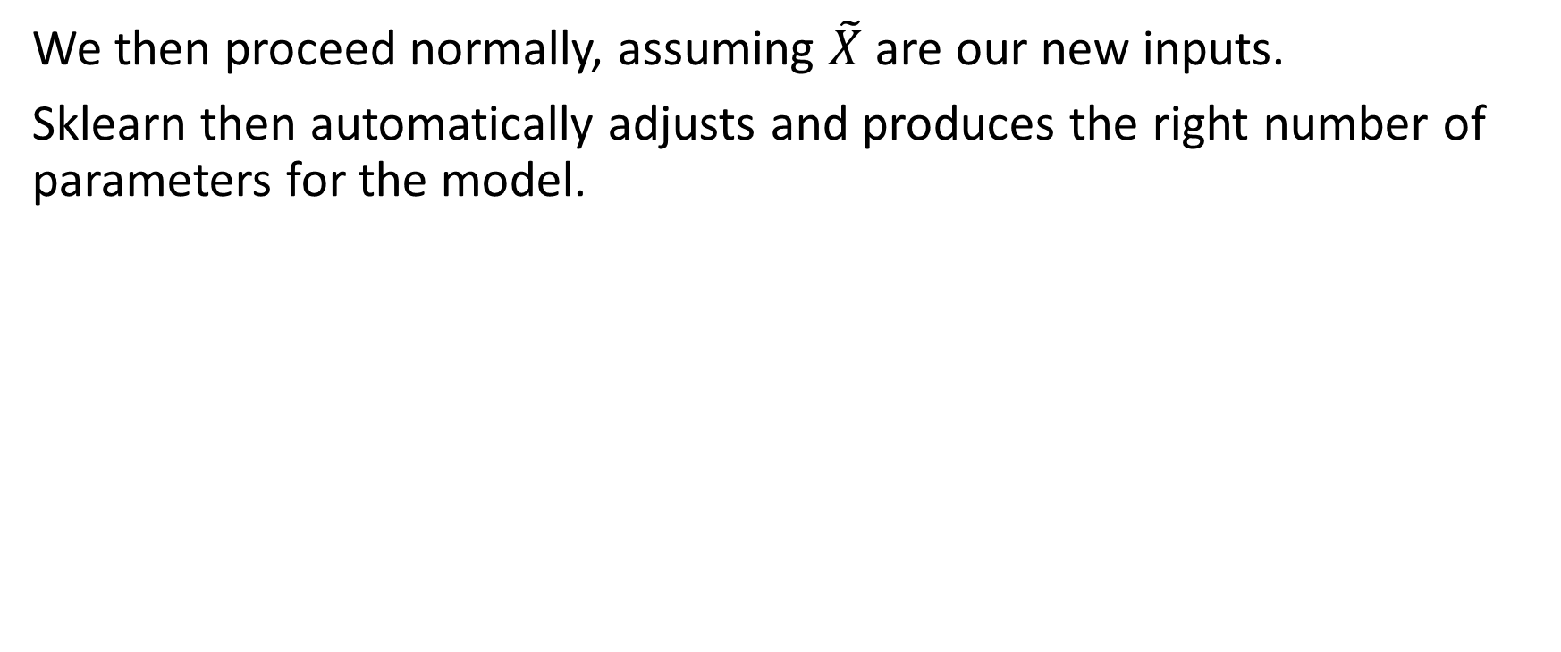
Polynomial Regression with sklearn
We then proceed normally, assuming $\tilde{X}$ are our new inputs.
Sklearn then automatically adjusts and produces the right number of parameters for the model.

Slide 12
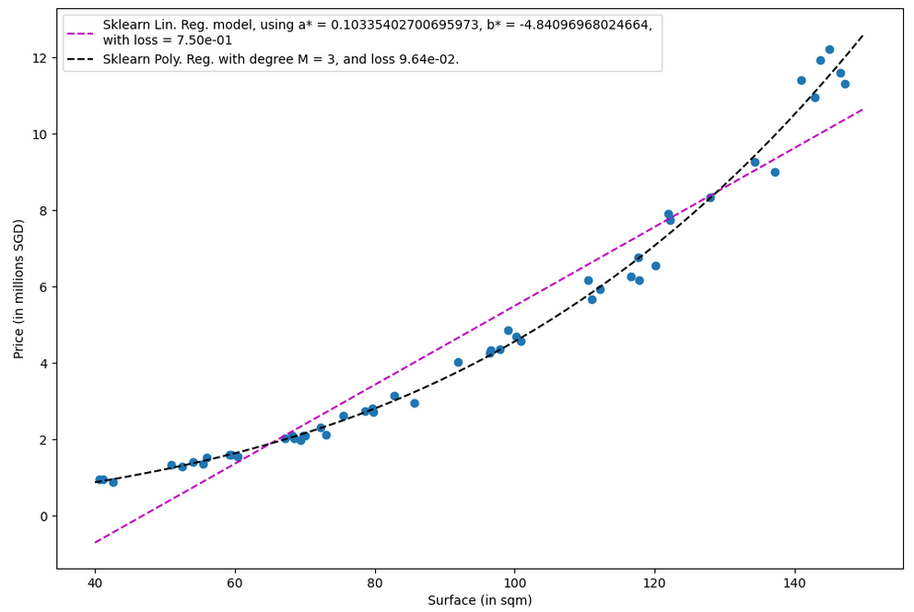
A much better fit, with a lower MSE loss

Slide 13
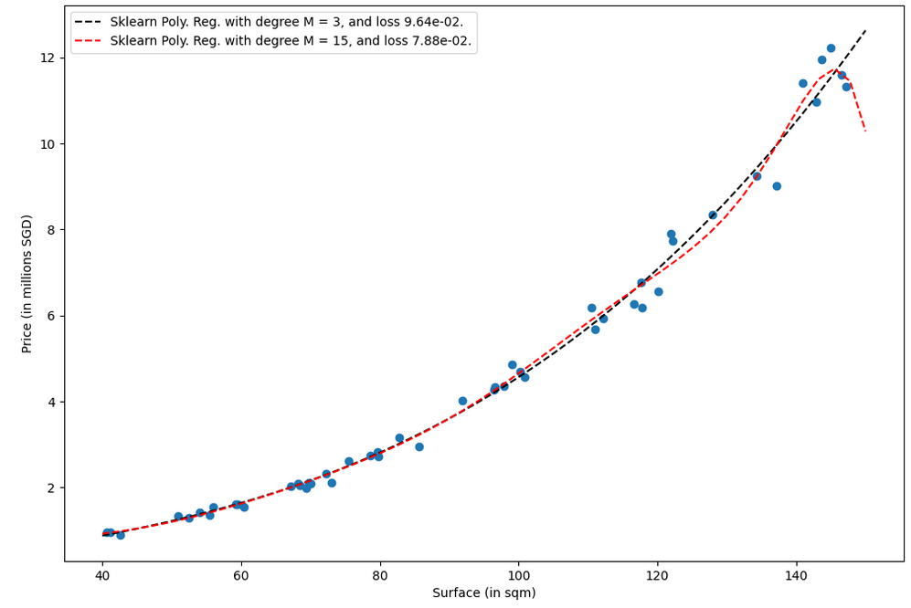
Be careful however on the degree you use for the polynomial regression.
Higher degree is not always better!

Slide 14
Be careful however on the degree you use for the polynomial regression.
Higher degree is not always better!
Red model (high degree) will struggle to predict price of a 150sqm apartment!

Slide 15
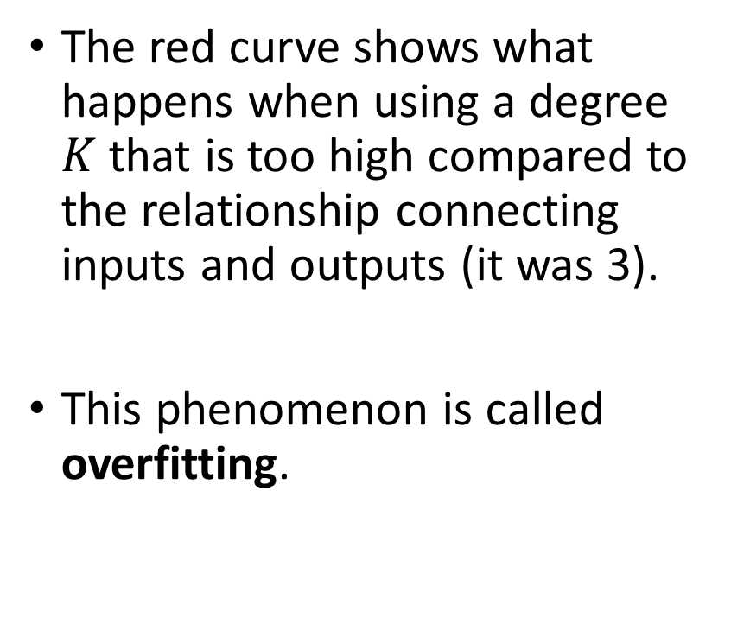
Overfitting vs. degree of polynomial
The red curve shows what happens when using a degree $K$ that is too high compared to the relationship connecting inputs and outputs (it was 3).
This phenomenon is called overfitting.

Slide 16
Overfitting vs. degree of polynomial
Definition (Overfitting):
Overfitting is a phenomenon that occurs in machine learning when a model is trained too well on the training data.
As a result, it may perform poorly on new, unseen data (here an apartment with 150sqm surface, which was not present in the training dataset).

Slide 17
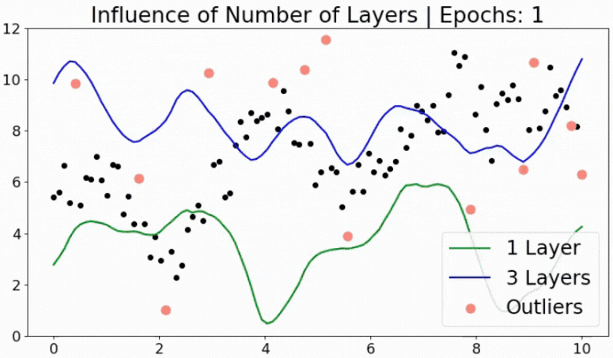
In practice, it may also look like the blue curve, which produces “spikes” to reach outliers.
This will lead to questionable predictions on certain input values.

Slide 18
Overfitting vs. degree of polynomial
Definition (Overfitting):
Overfitting is a phenomenon that occurs in machine learning when a model is trained too well on the training data.
As a result, it may perform poorly on new, unseen data (here an apartment with 150sqm surface, which was not present in the training dataset).
This typically happens when
a model has too many parameters compared to what the dataset would need,
or there is imbalance in the data.
The model might then struggle to generalize to new unseen data.
In other words, it memorizes the noise in the dataset rather than learning the correct underlying pattern, and makes awkward predictions

Slide 19
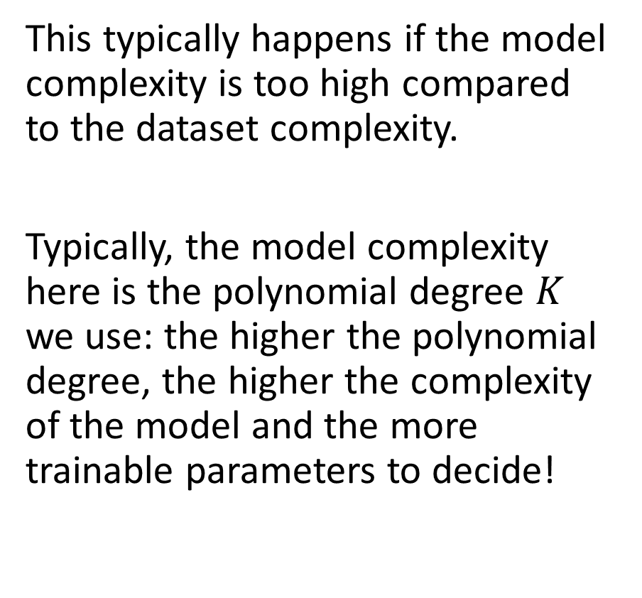
Overfitting vs. degree of polynomial
Definition (Overfitting):
Overfitting is a phenomenon that occurs in machine learning when a model is trained too well on the training data.
As a result, it may perform poorly on new, unseen data (here an apartment with 150sqm surface, which was not present in the training dataset).
This typically happens if the model complexity is too high compared to the dataset complexity.
Typically, the model complexity here is the polynomial degree $K$ we use: the higher the polynomial degree, the higher the complexity of the model and the more trainable parameters to decide!

Slide 20
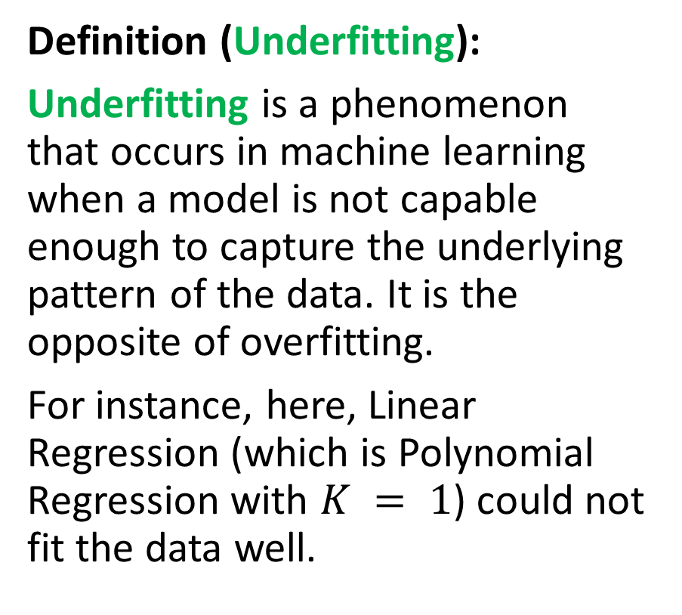
Underfitting vs. degree of polynomial
Definition (Underfitting):
Underfitting is a phenomenon that occurs in machine learning when a model is not capable enough to capture the underlying pattern of the data. It is the opposite of overfitting.
For instance, here, Linear Regression (which is Polynomial Regression with $K = 1$) could not fit the data well.

Slide 21
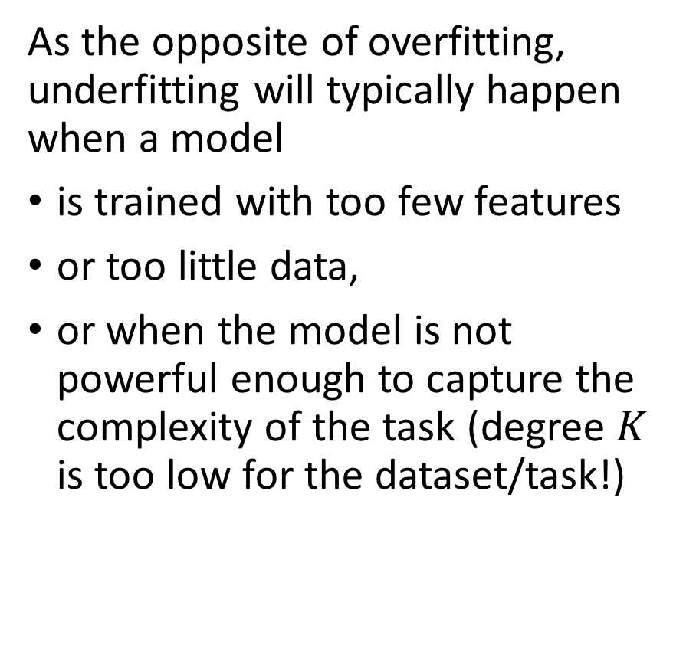
Underfitting vs. degree of polynomial
Definition (Underfitting):
Underfitting is a phenomenon that occurs in machine learning when a model is not capable enough to capture the underlying pattern of the data. It is the opposite of overfitting.
For instance, here, Linear Regression (which is Polynomial Regression with $K = 1$) could not fit the data well.
As the opposite of overfitting, underfitting will typically happen when a model
is trained with too few features
or too little data,
or when the model is not powerful enough to capture the complexity of the task (degree $K$ is too low for the dataset/task!)

Slide 22
Generalization
Definition (Generalization):
Generalization is considered the "holy grail" or ultimate goal of any machine learning model.
Even though the model was trained on known data we collected, the purpose of a machine learning model is always to generalize, i.e. to make accurate predictions on new, unseen data.
If a model can make accurate predictions on data it has not seen before, it is said to have generalized well, and can then be used in the real world for solving the problem it was trained to solve.

Slide 23
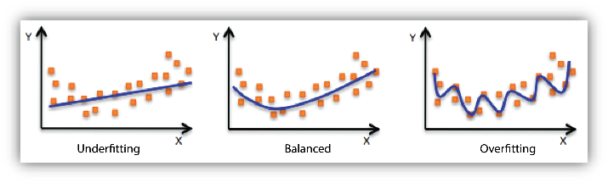
Generalization vs. Overfitting/Underfitting
In general, having a model that is underfitting or overfitting will lead to poor generalization.
We would very much prefer to fit the data “just right”.

Slide 24
While we are at it…
In general, we want to:
Train the model on the data we collected for this task,
Confirm that the model can generalize and make accurate predictions on new, unseen data, after training.
Problem: We would prefer to test the model before releasing it in the wild (what if it is wrong?)
Problem #2: Testing its generalization capabilities on the same data that was used for training would NOT confirm generalization.
Solution: Use some of our seen data to train the model, and some of the data (that has not been used for training and is therefore unseen to the model yet) for evaluating its generalization.

Slide 25
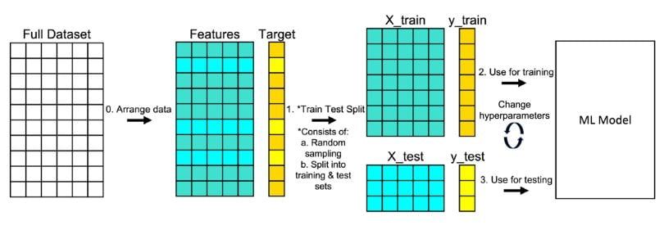
Train and test split
Definition (Train and Test Split):
Train and test split is a method used in machine learning to divide a dataset into two subsets:
The training dataset is used to train the model.
The test dataset is used to evaluate the model performance after training.
The idea is to use a portion of the dataset for training and a separate portion for testing so that the model can be evaluated on unseen data.
The typical split is to use 80% of the data for training and 20% for testing.
This can however vary depending on the specific use case and the size of the dataset.

Slide 26
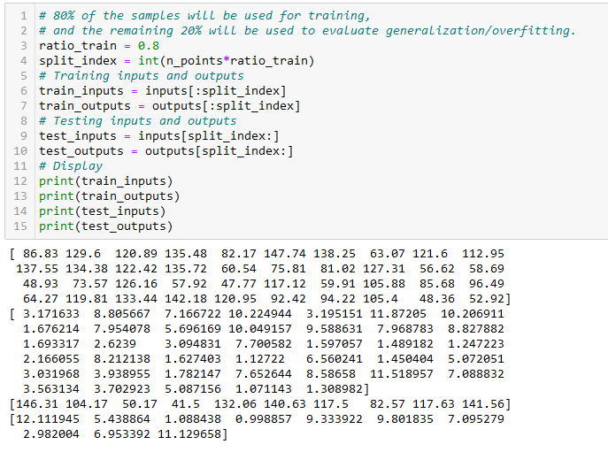
Train and test split

Slide 27
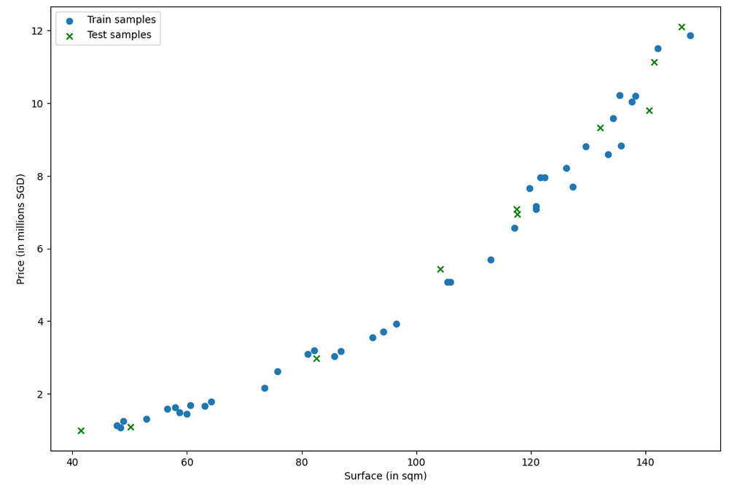

Slide 28
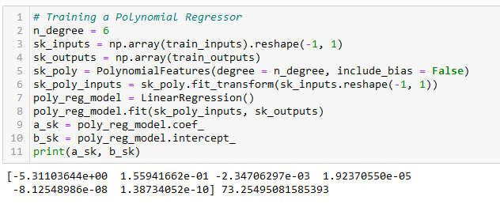
Training the Polynomial Regressor, again
This time, we only train the polynomial regressor on the training data.
After training, evaluate loss using the test data.

Slide 29
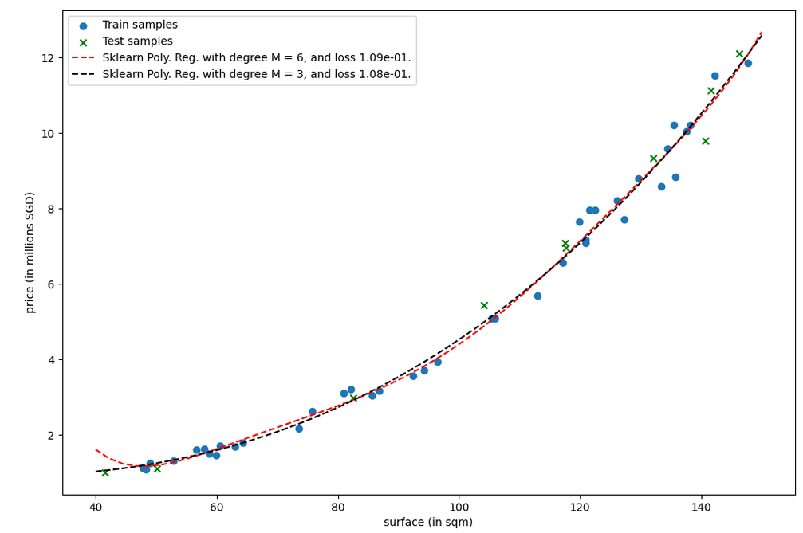
Red curve is higher degree polynomial regression. While it seems like it should perform better than black, its test loss is higher!
What could be the reason?

Slide 30
Red curve is higher degree polynomial regression. While it seems like it should perform better than black, its test loss is higher!
What could be the reason?
Bad fitting on low surface apartments!
(No apartment with size less than 45sqm in train dataset!)

Slide 31
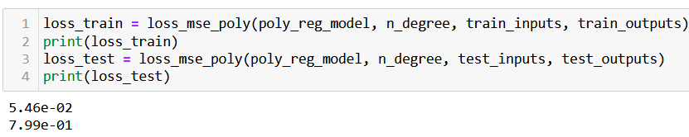
Spotting over/underfitting
A typical way to identify overfitting or underfitting is to look at two loss values: the loss calculated using samples from the training set and the one calculated using samples from the test set.
Observation: In general, the train loss has a smaller value than the test one, but they should remain on similar orders of magnitude.
If not, then there might be underfitting or overfitting.

Slide 32
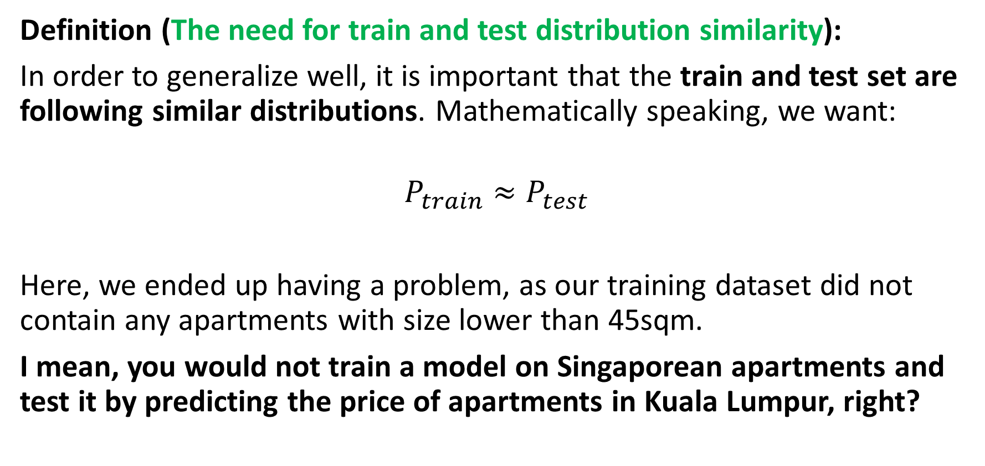
Generalization vs. Train/Test Distributions
Definition (The need for train and test distribution similarity):
In order to generalize well, it is important that the train and test set are following similar distributions. Mathematically speaking, we want:
$$P_{train}≈P_{test}$$
Here, we ended up having a problem, as our training dataset did not contain any apartments with size lower than 45sqm.
I mean, you would not train a model on Singaporean apartments and test it by predicting the price of apartments in Kuala Lumpur, right?

Slide 33
But then, why did black end up being ok then? It had not seen the <45sqm data either!

Slide 34
Regularization
Definition (Regularization):
Regularization consists of techniques, whose purpose is to help the model to reduce the odds of overfitting.
It can typically be done by making sure the model is not too complex for the data, but many other approaches exist.
In general,
Scale model and dataset complexity: the more complex the data is (in terms of features), the more complex the model can/should be.
Scale model and dataset size: the more data you have (in terms of quantity of individual samples in dataset), the more complex the model can be.

Slide 35
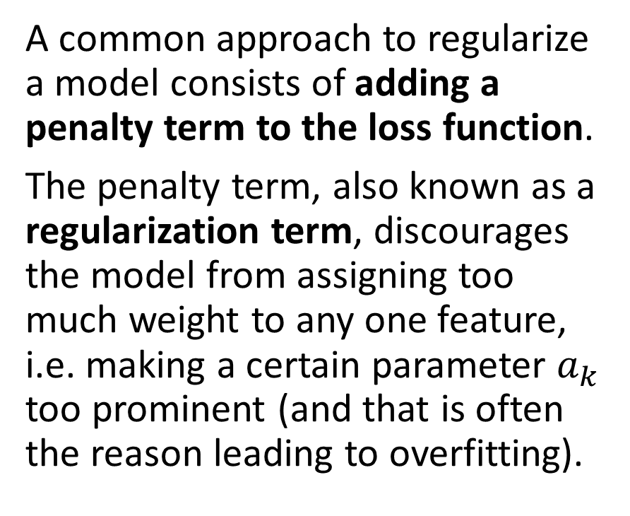
Regularization
Definition (Regularization):
Regularization consists of techniques, whose purpose is to help the model to reduce the odds of overfitting.
It can typically be done by making sure the model is not too complex for the data, but many other approaches exist.
A common approach to regularize a model consists of adding a penalty term to the loss function.
The penalty term, also known as a regularization term, discourages the model from assigning too much weight to any one feature, i.e. making a certain parameter $a_{k}$ too prominent (and that is often the reason leading to overfitting).

Slide 36
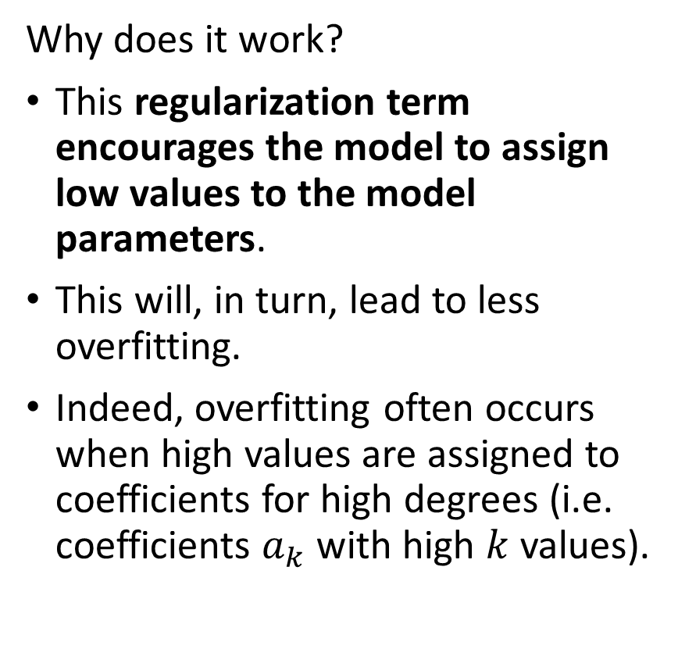
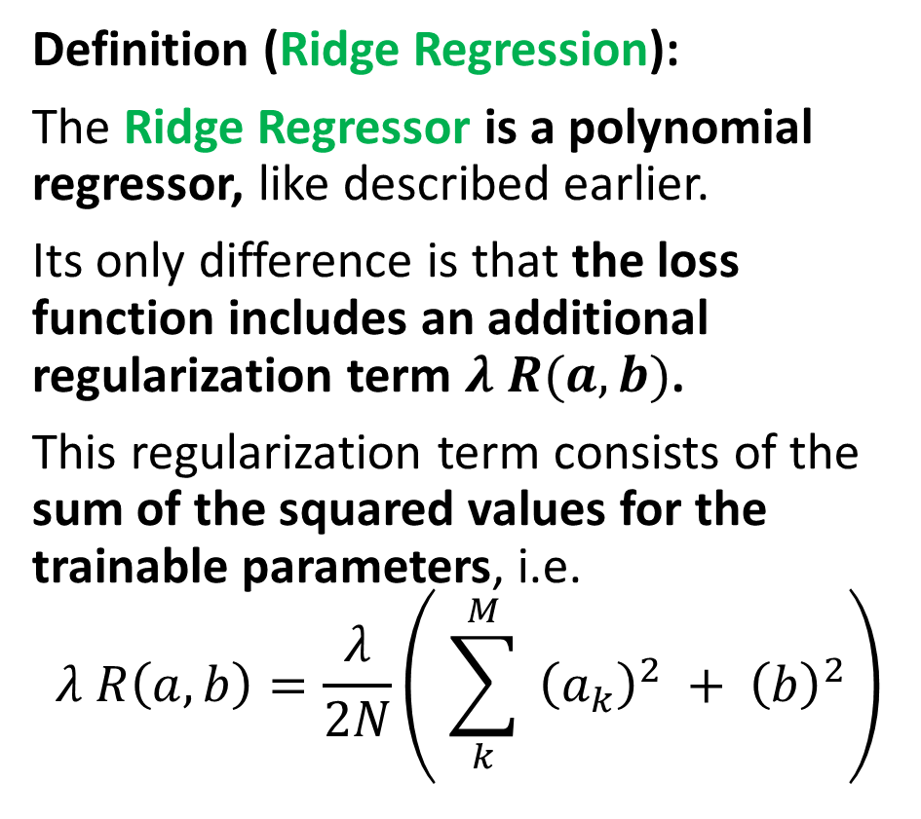
Regularization
Definition (Ridge Regression):
The Ridge Regressor is a polynomial regressor, like described earlier.
Its only difference is that the loss function includes an additional regularization term $λ R(a, b)$.
This regularization term consists of the sum of the squared values for the trainable parameters, i.e.
$$λ R\left(a, b\right)=\frac{λ}{2N}\left( \sum_{k}^{M}{{ \left(a_{k}\right)}^{2}} + {\left(b\right)}^{2}\right)$$
Why does it work?
This regularization term encourages the model to assign low values to the model parameters.
This will, in turn, lead to less overfitting.
Indeed, overfitting often occurs when high values are assigned to coefficients for high degrees (i.e. coefficients $a_{k}$with high $k$ values).

Slide 37
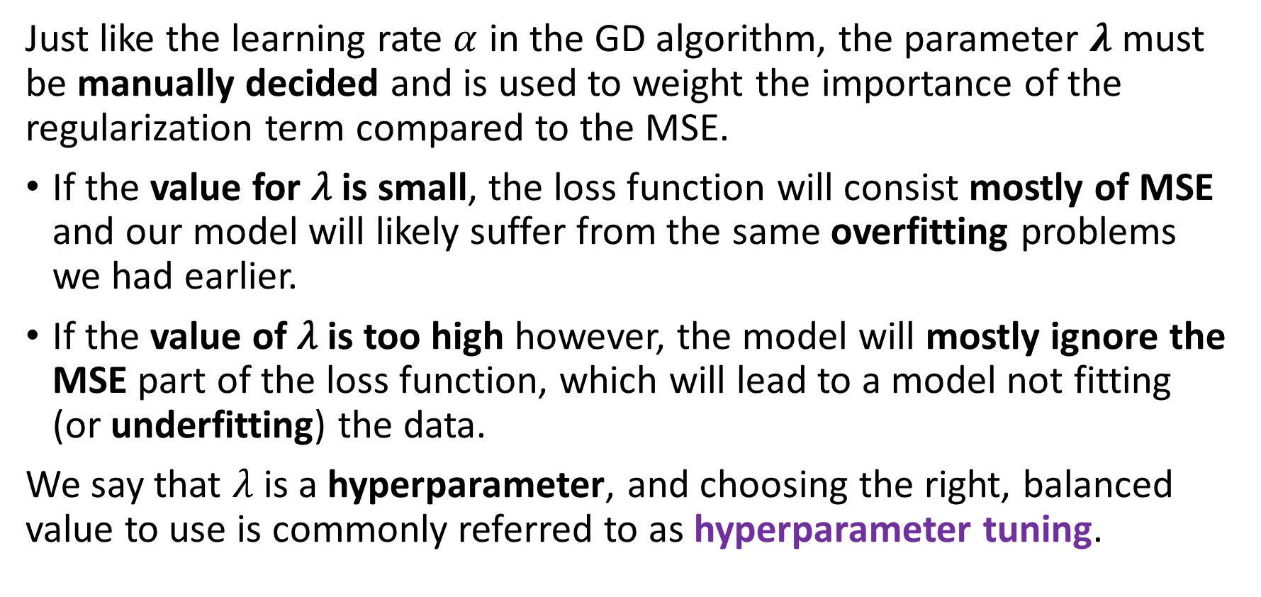
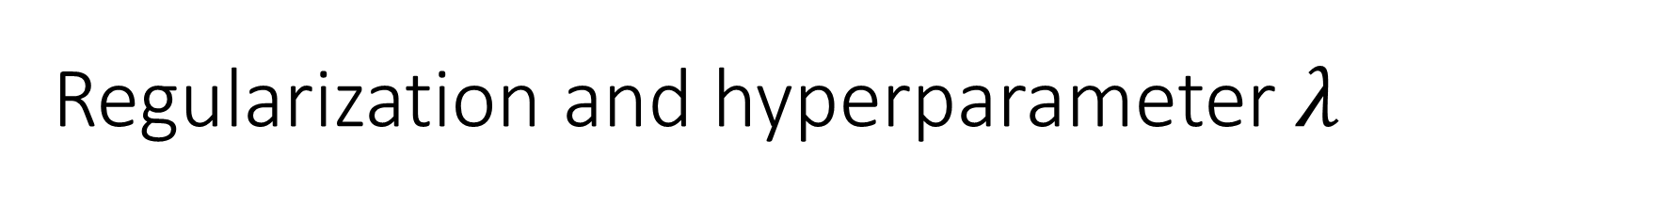
Regularization and hyperparameter $λ$
Just like the learning rate $α$ in the GD algorithm, the parameter $λ$ must be manually decided and is used to weight the importance of the regularization term compared to the MSE.
If the value for 𝜆 is small, the loss function will consist mostly of MSE and our model will likely suffer from the same overfitting problems we had earlier.
If the value of 𝜆 is too high however, the model will mostly ignore the MSE part of the loss function, which will lead to a model not fitting (or underfitting) the data.
We say that $λ$ is a hyperparameter, and choosing the right, balanced value to use is commonly referred to as hyperparameter tuning.

Slide 38
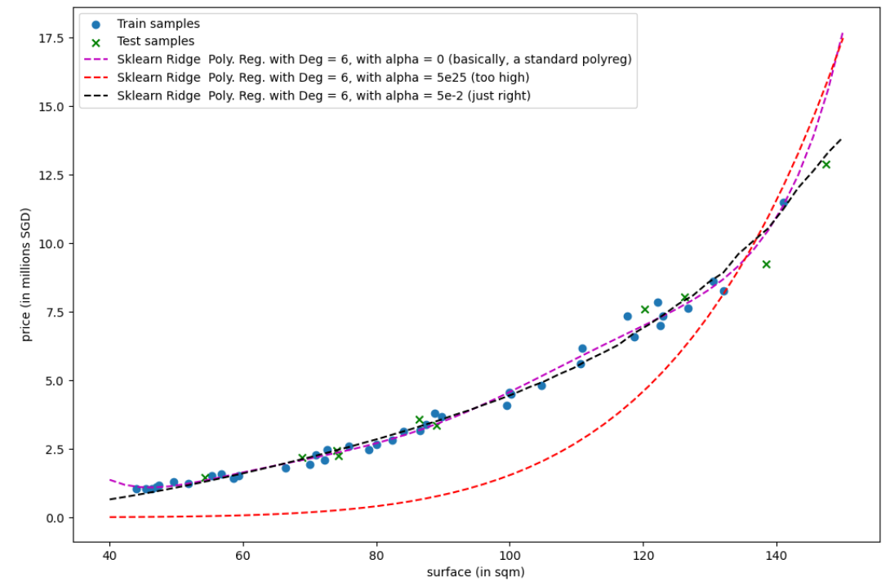

Slide 39
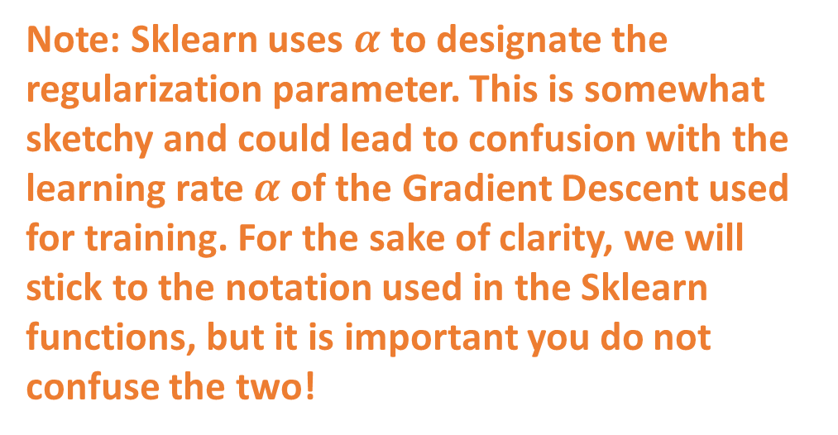
Note: Sklearn uses $α$ to designate the regularization parameter. This is somewhat sketchy and could lead to confusion with the learning rate $α$of the Gradient Descent used for training. For the sake of clarity, we will stick to the notation used in the Sklearn functions, but it is important you do not confuse the two!

Slide 40
Regularization with other things than L2?
Also possible to use the sum of absolute values (or what we call a L1 regularization), making a Lasso Regressor instead of a Ridge Regressor.
Why use L1 regularization over L2 regularization?
L1 regularization results in some weights being exactly equal to zero, which can be used for feature selection.
L2 regularization will not produce sparse models, and it will only shrink the weights.
Why prefer L1 over L2 (and vice versa)? Have a look at this, if curious! https://medium.com/@fernando.dijkinga/explaining-l1-and-l2-regularization-in-machine-learning-2356ee91c8e3

Slide 41
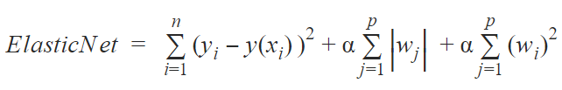
Regularization with other things than L2?
Also possible to use the sum of absolute values AND squared values as regularization, i.e. combining the L1 and L2 regularizations together.
Essentially getting the best of both worlds, and making an Elastic Regressor instead! (MSE + L1 Reg + L2 Reg)
MSE
L1
L2

Slide 42
Let us call it a break for now
We will continue on the next lecture

